Slide 1
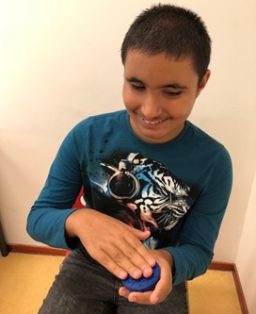
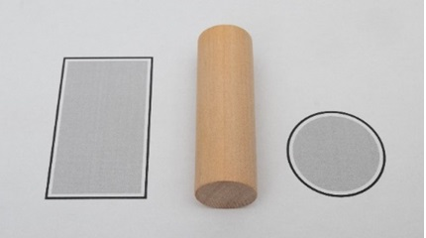
Tactile Reading 2021
Tactual Profile MDVI
Learning path for
the transition from
3D to 2D

Slide 2
Introduction of presenters
Ans Withagen Brenda Zwijnenburg Anneke Blok

Slide 3
Design of presentation
Introduction of the MDVI version of Tactual Profile
Short video fragment of Tactual Profile
Feel Free MDVI
Learning path for the transition from 3D to 2D
Some examples of lessons

Slide 4
Tactual Profile MDVI
Reason for development:
Request for an adjusted instrument of Tactual Profile for people with a severe visual and mental disability, to monitor tactual functioning
Projectgroup started to develop this version in 2014
Project group: Behavioral scientist PhD in special education, occupational therapists,
teacher MDVI, rehabilitation therapist in early intervention, speech therapist
Expert group: neuro psychologist and other professionals in the field of MDVI and an expert of the the Radboud University Nijmegen

Slide 5
Tactual Profile: starting point MDVI version

Slide 6
Target group
Target group Tactual Profile:
Children, 0-16 years of age, who are born blind or who have no more than some residual vision
Target group Tactual Profile MDVI:
Persons with MDVI, a severe visual and cognitive impairment.
Cognitive development from 0-6 years of age

Slide 7
Differences between Tactual Profile and Tactual Profile MDVI
Extended interview with a parent, teacher or care taker
Instruction is less verbal
Steps are more refined in the items
Observation in daily environment
Practical Skills not included in item-set

Slide 8
Tactual Profile MDVI

Slide 9
Domains & Categories
Tactual sensory functioning
Tactual motor functioning
Tactual perceptual functioning

Slide 10
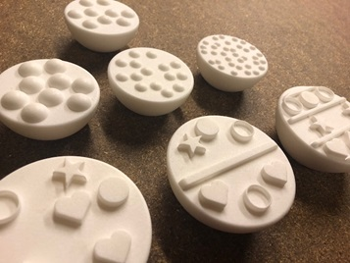
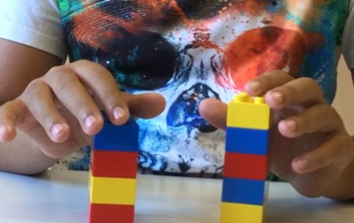
Tactual Sensory Functioning
Noticing
Body awareness
Touch sensitivity
Proprioception

Slide 11
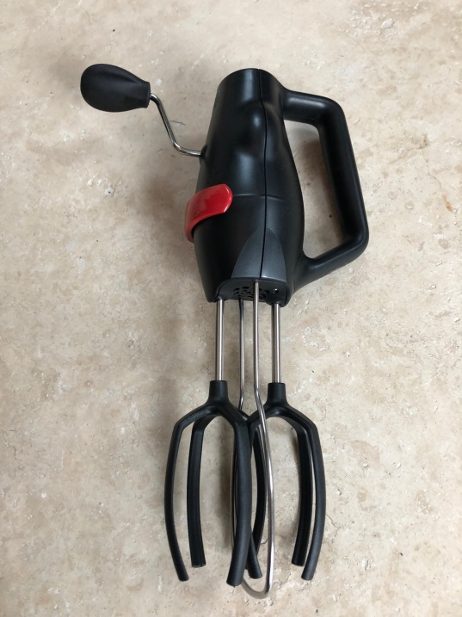
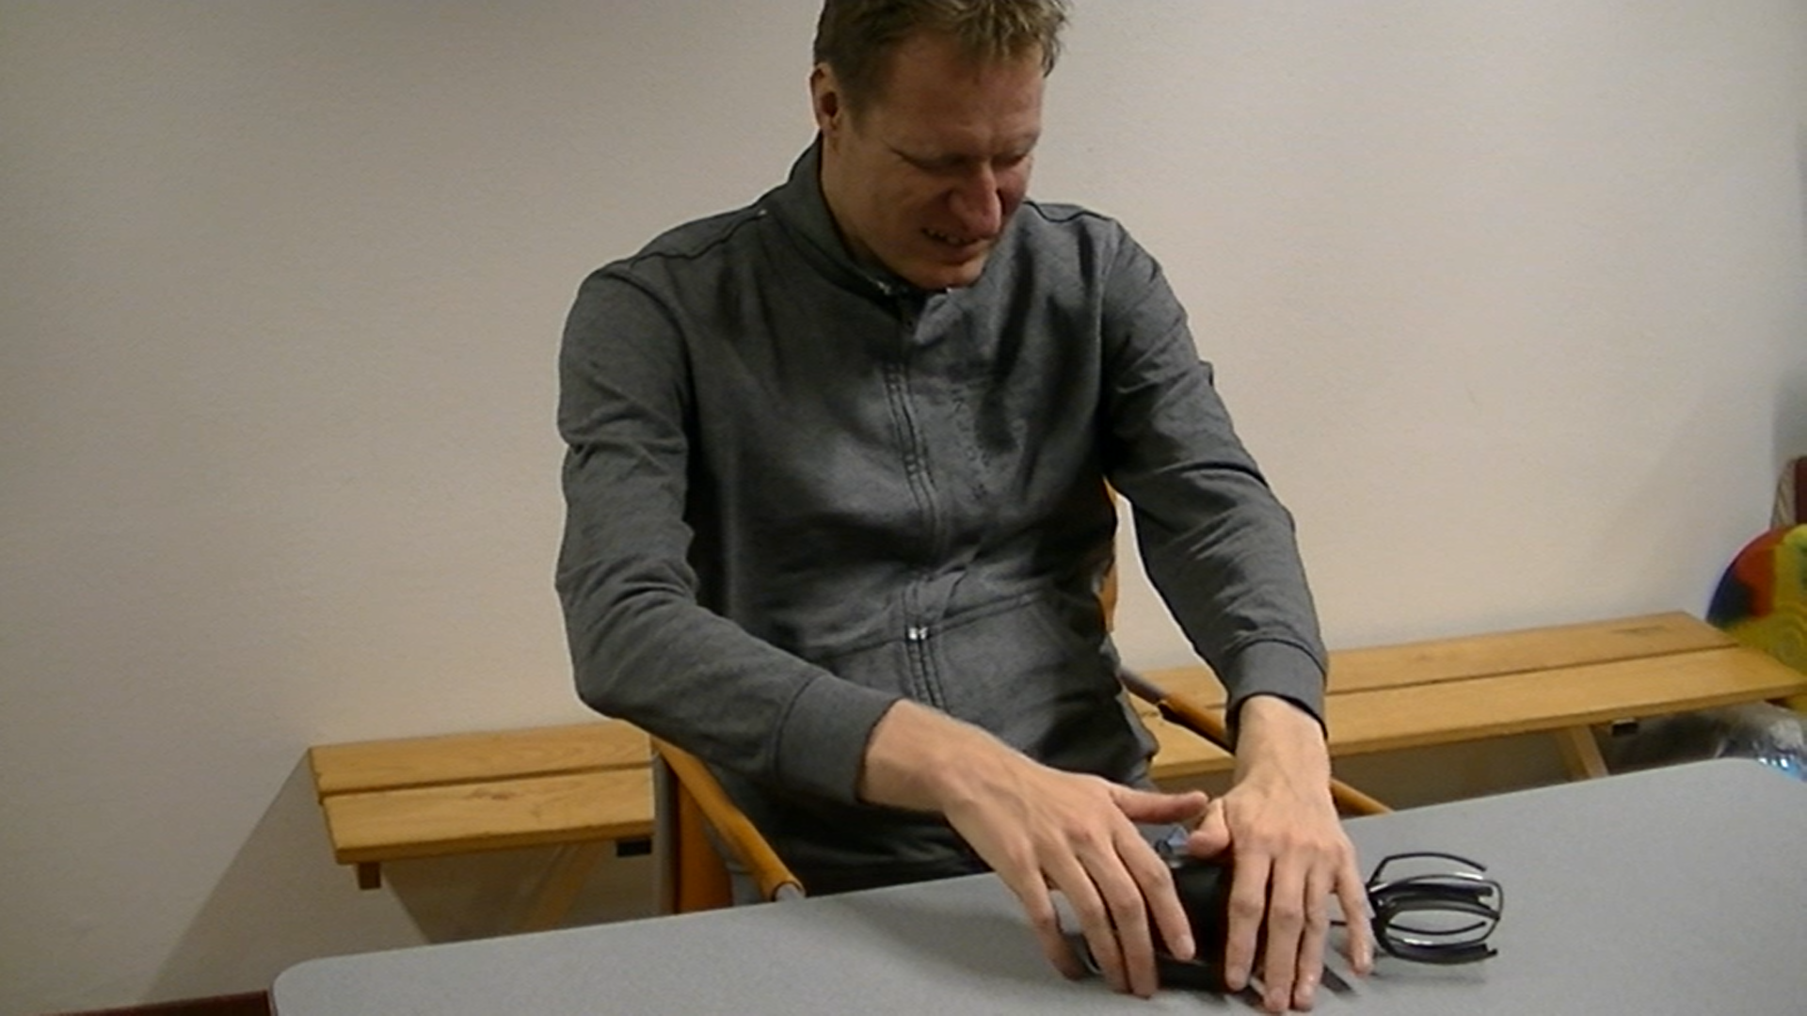
Tactual Motor Functioning
Tactual exploration
Two-handedness

Slide 12
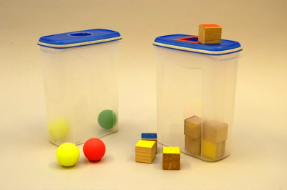
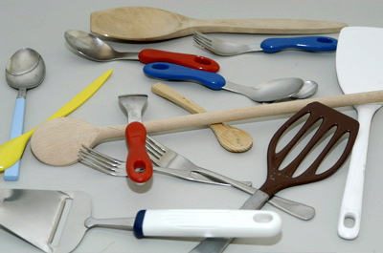
Tactual Perceptual Functioning
Recognition
Perception of detail
Part-whole relationship
Tactile-spatial relationships
Figure-ground perception
Tactual Language
Touch strategy

Slide 13
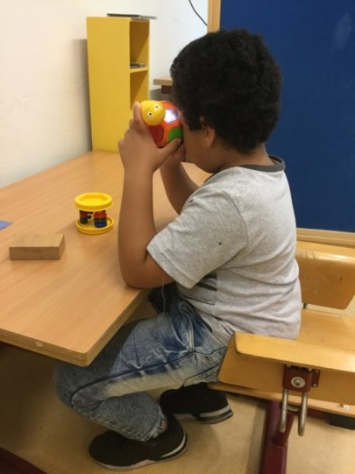
Survey with Influential Factors
Client-variables: Stimulus-variables:
- Motor Skills - Environmental factors
- Consciousness - Material properties
- Regulation of sensory - Distracting factors
stimuli
- Exploration style
- Attention
- Memory
- Executive functions

Slide 14
Short filmfragment Tactual Profile MDVI

Slide 15
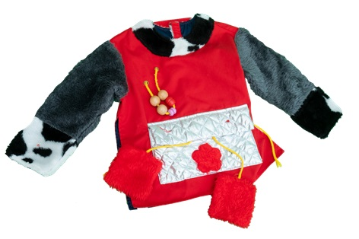
Feel Free MDVI
Materials for 100
activities to stimulate
tactual functioning
Anneke Blok
Ineke Jacobs
Fiona Penning
Katrien Kouters
Miranda Zwijgers

Slide 16
Categories
Touching and perceiving
Touching and moving
Touching and understanding

Slide 17
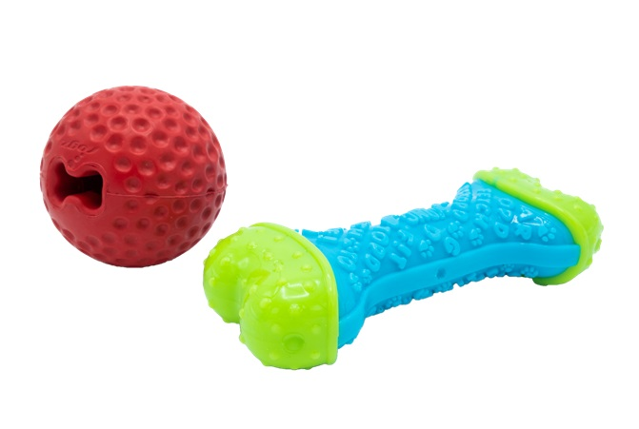
Category: Touching and understanding
Perception of details: feeling details in dog toys

Slide 18
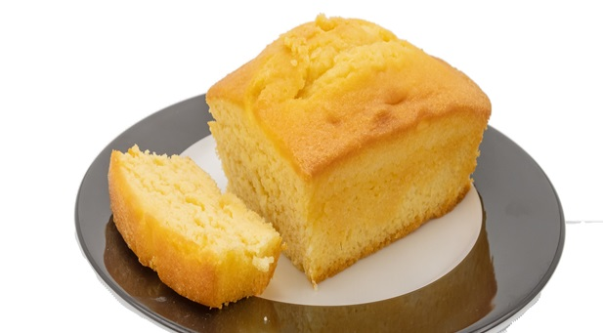
Category Touching and perceiving
Touch sensitivity: baking a cake

Slide 19
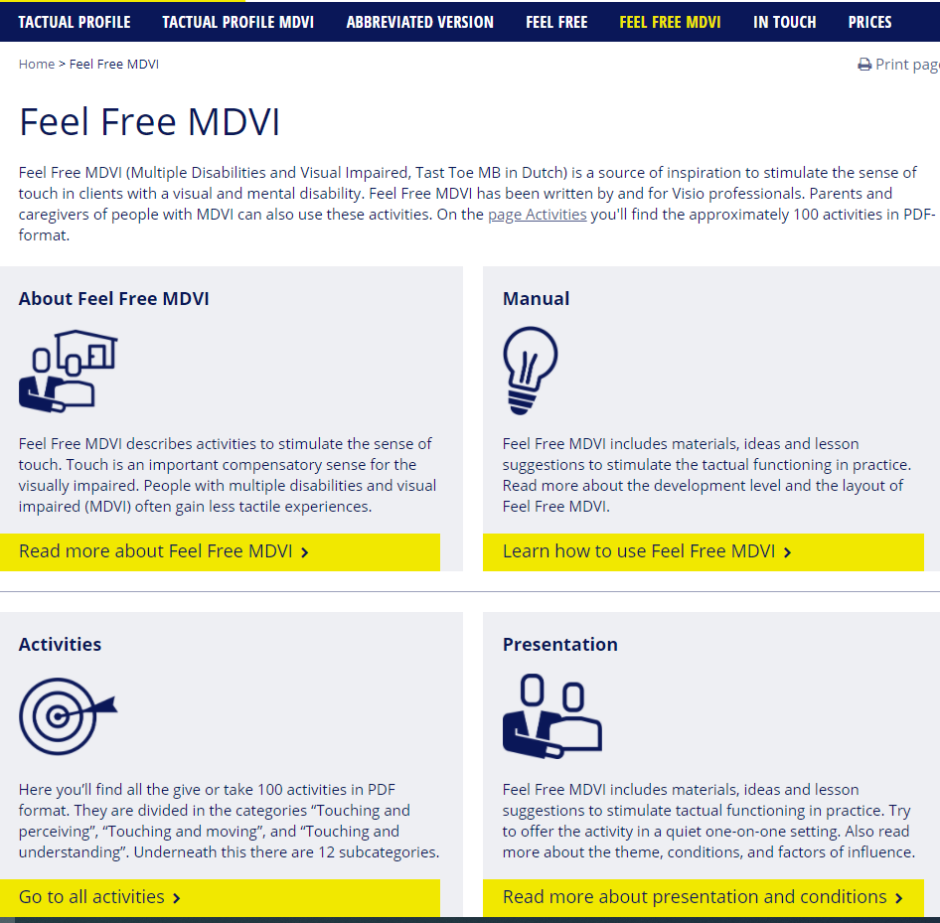
www.tactualprofile.org
tactualprofile@visio.org

Slide 20
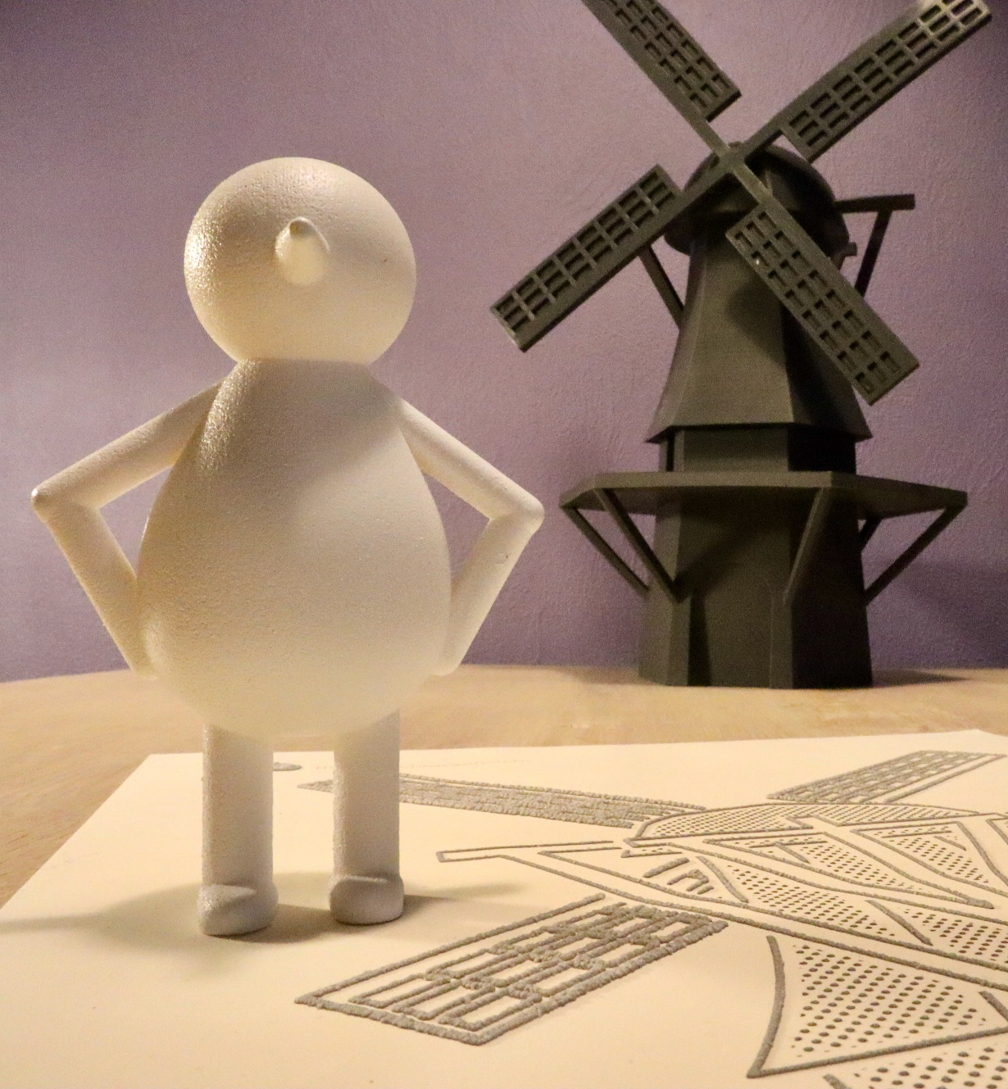
Learning path Transition 3D-2D

Slide 21
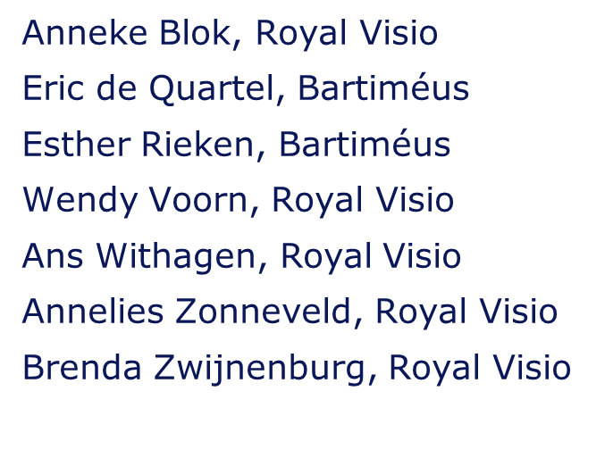
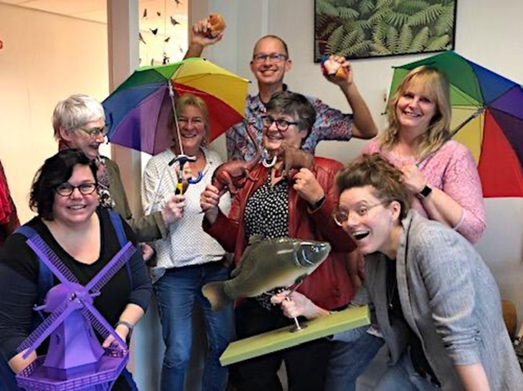
Project group Royal Dutch Visio + Bartiméus

Slide 22
Aim of the project
To develop an educational guideline to gain blind children insight in the transformation of a three-dimensional object into a two-dimensional tactile drawing.
With this learning path, the relationship between objects and associated drawings, which can be produced by different viewpoints, is explained step by step. The learning path increases in complexity and difficulty level.

Slide 23
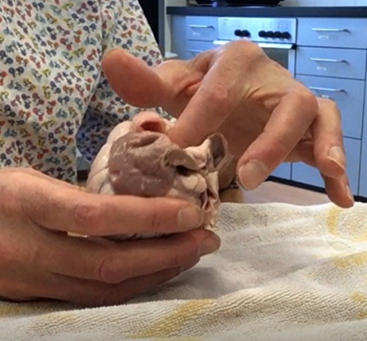
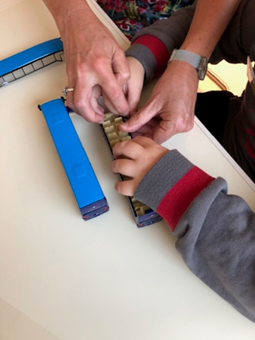
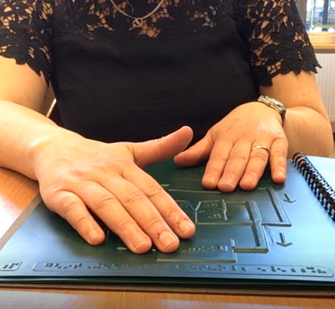
Workshops
We checked the added value for a blind person to gain more insight in the transformation of a 3D model into a tactile drawing.

Slide 24
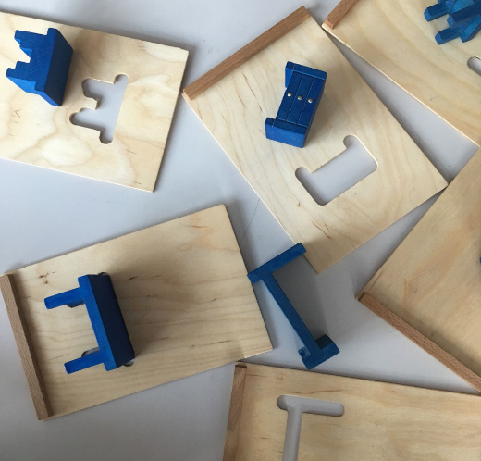
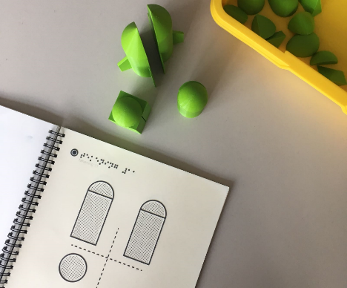
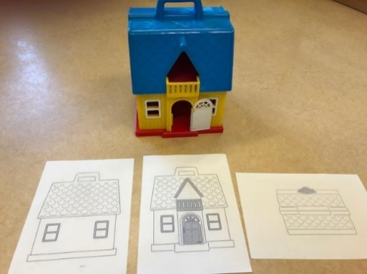
Statements after the workshop
“We learned a lot today! I never knew about the different viewpoints of an object. Really did not know that you depict this in different ways. It’s an enriching experience. Learning this also gives me a different view of the world and objects in my environment. If I had learned this younger, I would perhaps have asked different questions and would have gained a richer concept of the world.

Slide 25
Starting points
Participation of pupils in regular schools​
Focus of the learning path: practicing insights in the transition of 3D into 2D. The learning path does not focus on concept development​
The learning path is not a fixed pattern: it should be used in line with the insight and understanding of the pupil​
​

Slide 26
Structure in levels (age is indication)
Preparatory phase: age level 4-7​
​
Initial phase: age level 7- 10​
​
Continuous phase: age level 11+​

Slide 27
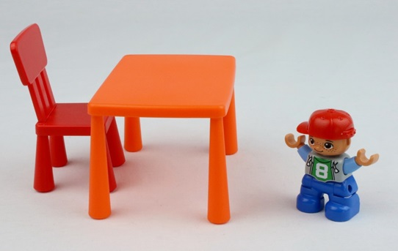
Checklist

Slide 28
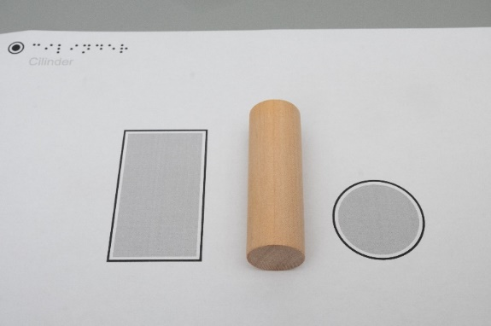
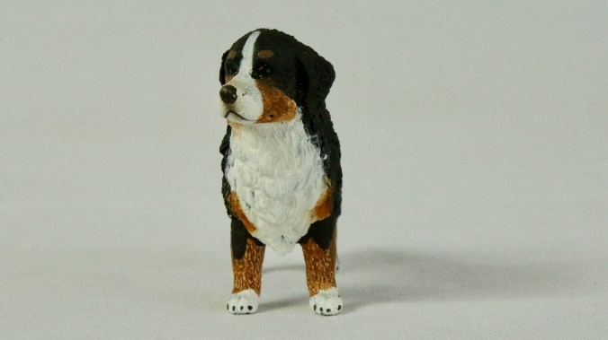
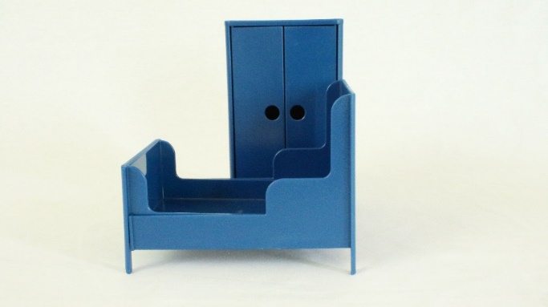
Insights A to S
Insight F: Insight H: Insight K: ‘occlusion’
something round human, animal or object, overlap in a drawing,
can be depicted straight can have more legs from something that is partially
another point of view depicted is behing the
object that you fully perceive

Slide 29
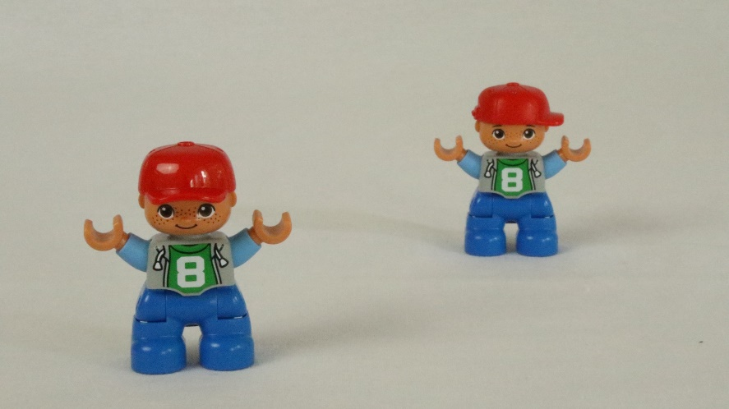
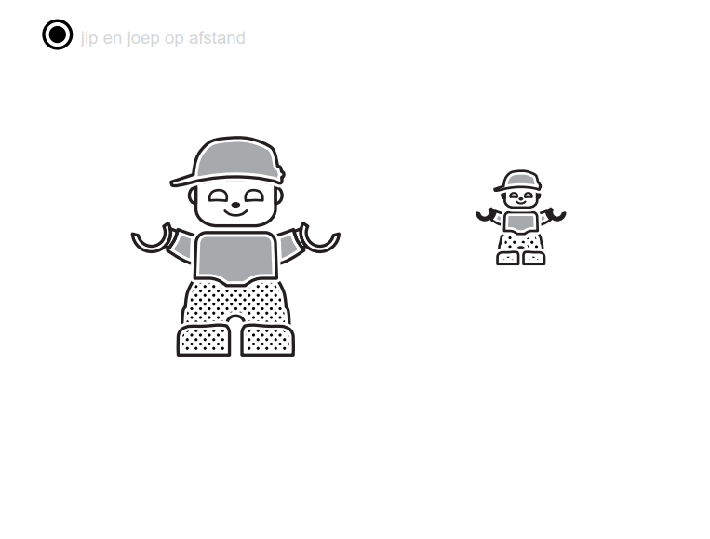
Insight Q
Knowing that something closer is depicted larger and that is further away is depicted smaller

Slide 30
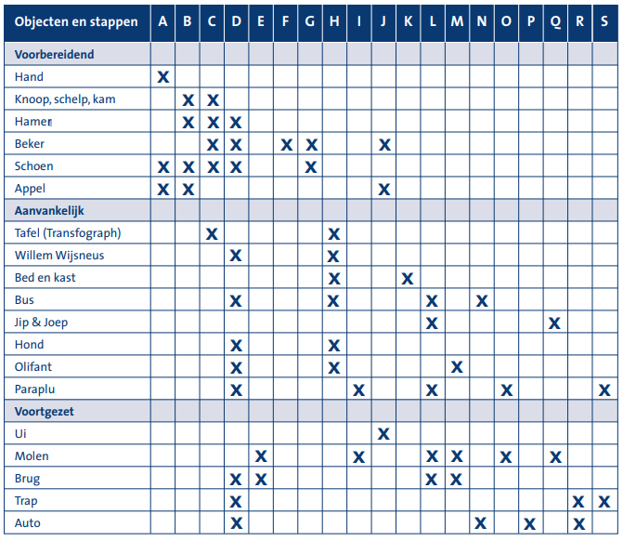
19 Lesson descriptions concerning the insights with special materials and drawings

Slide 31
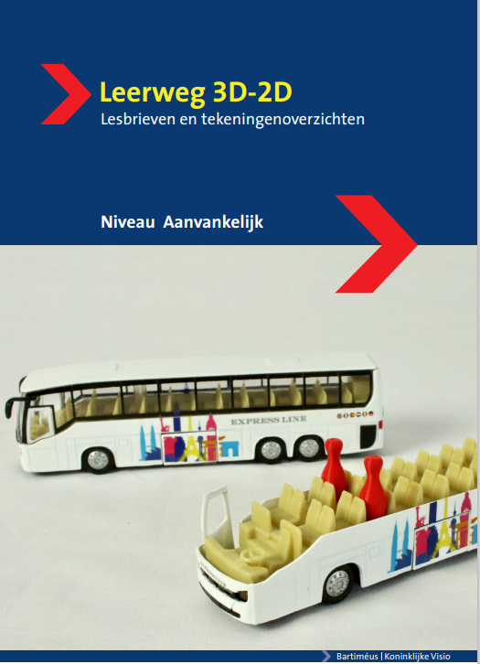
Instruction manual and written lessons for each phase

Slide 32
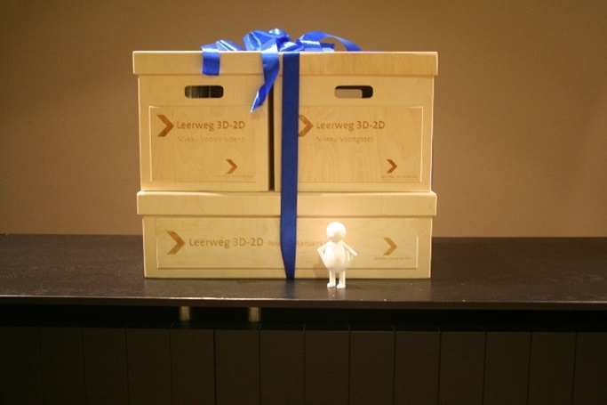
Let’s open the box

Slide 33
3 phases: 3 boxes
Prepatory phase:​
Emphasis on: Experiencing the transition (3D- through 2.5D- to 2D)​
Objects are familiar​
Drawings are real life size ​
​
Objects: ​
Hand​
Comb, Shell and Button
Hammer
Cup
Shoe​
Apple

Slide 34
Lethe Hammer​
​
Lesson Hammer
Teachers instructions:
Description of insights and goals, materials, activities, points of observation and attention.
Lessons contain standard curricular activities and more challenging ones.

Slide 35
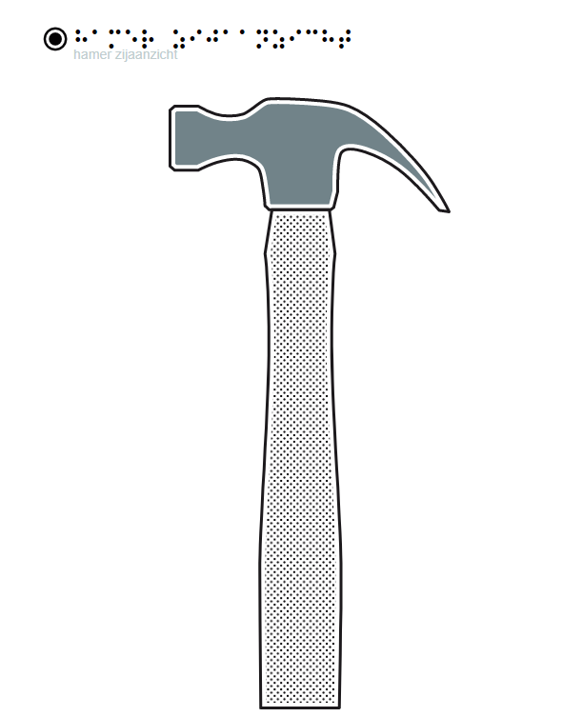
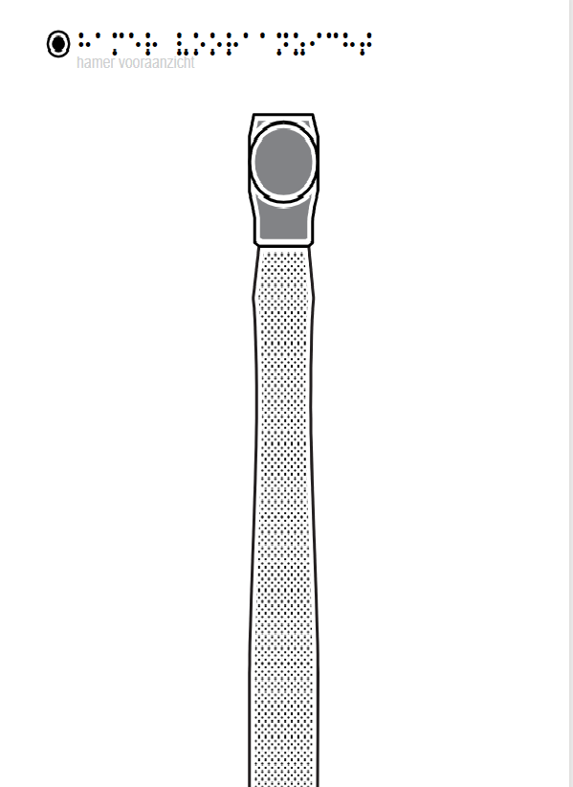
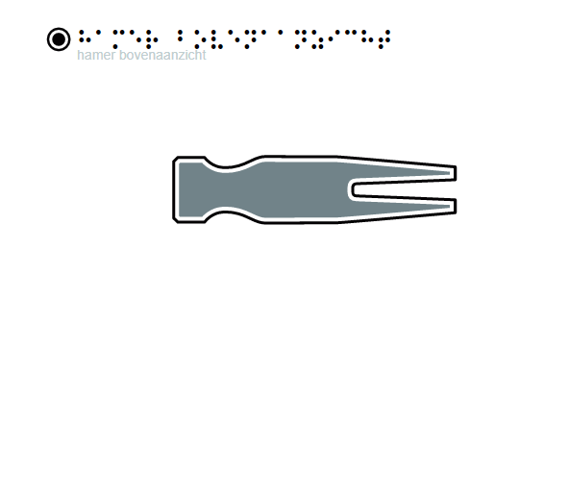
​
The Hammer drawings: 3 different points of view

Slide 36
3 phases: 3 boxes
Initial phase:​
Objects are still familiar​
Scale is introduced; objects and drawings may differ in size.
Some insights are repeated, and new ones are introduced
​Objects: ​
Table
Bed and Closet
Willem Wijsneus
Bus
Twin brothers
Dog and Elephant
Umbrella

Slide 37
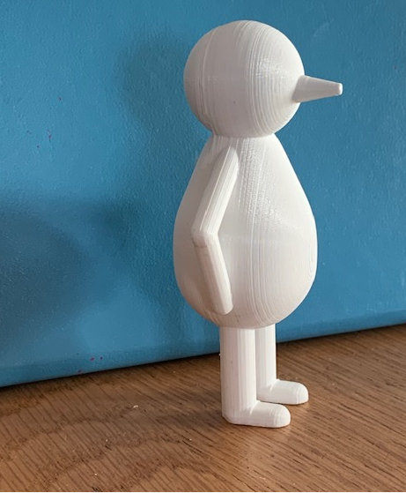
Our mascot:
Willem Wijsneus
Literally translated:​
William Pointy Nose​
​
Figuratively translated:​
William Smartass​
​
The pointing of his nose
is used to explain
the insight point of view. ​

Slide 38
The Bus:​
​
Insights like:​
​
A wrong and a right drawing to choose from​
Working with refence points​
Working with a floor plan​

Slide 39
3 phases: 3 boxes
Continuous phase:​
Objects and drawings are more complex
Some insights return but are treated on a more complicated level
New complex insights are introduced
​
Objects: ​
Onion
Windmill
Bridge
Staircase
Car

Slide 40
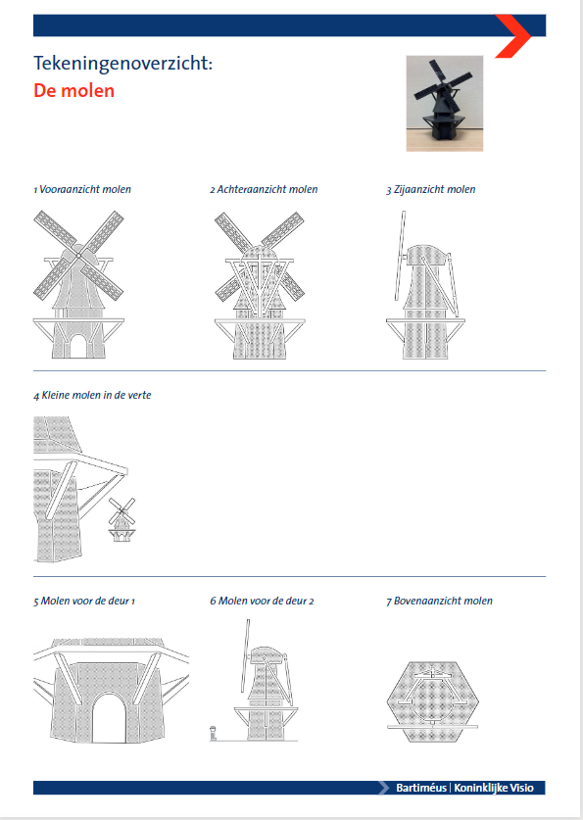
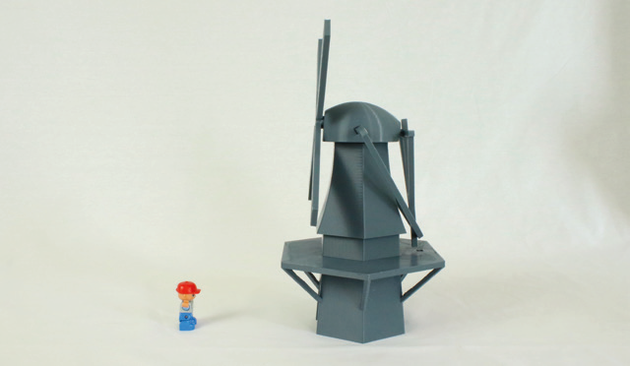
The Windmill
One of the more eloborated and complex lessons. ​
​
​
​
​
​

Slide 41
Special Thanks
Prof. Dr. Boguslaw Marek​
Dr. Mathijs Vervloed

Slide 42
More information
For more information
about these presentations and the presented products visit​
​
​
www.visio.org/tactile-reading-2021​
​

