Slide 1
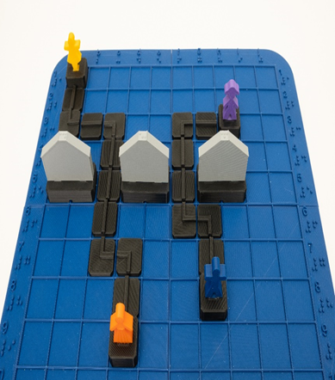
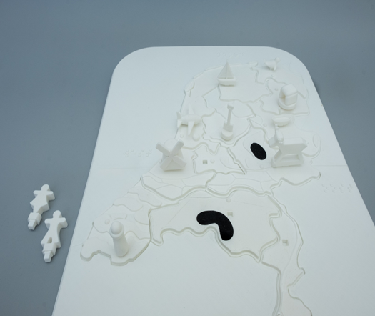
Preparatory Topography An and Jan and Where am I?

Slide 2
Royal Dutch Visio, centre of expertise for blind and partially sighted people
Projectgroup:
Marianne van der Vinne: creator An and Jan
Visio Education, itenerant teacher
Stephanie van Lenningh: Visio Education, teacher
Yvette Verweij:Visio Education, itenerant teacher
Anneke Blok: Visio Rehabilitation, rehabilitation therapist

Slide 3
Manual
Lessons in 3 parts:
1. 3D board: 10 lessons
2. Transition to tactile
graphics: 10 lessons
3. Lessons mathematics:
8 lessons

Slide 4
Targetgroup: Braille readers age 6-12 years Marianne gives instructions to Isa

Slide 5
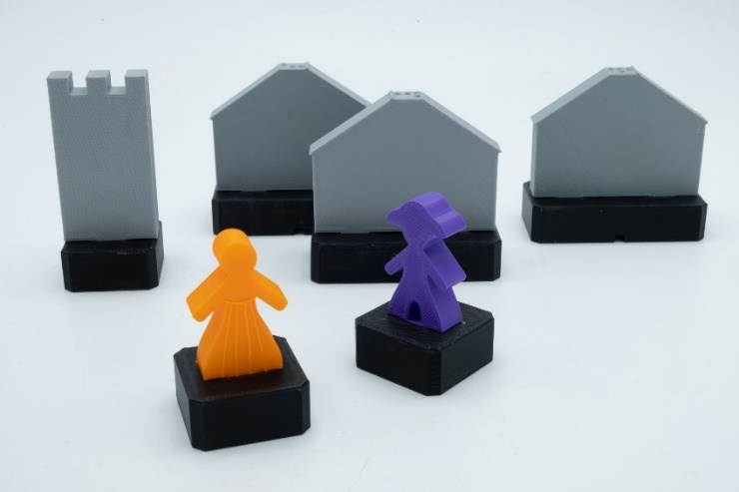
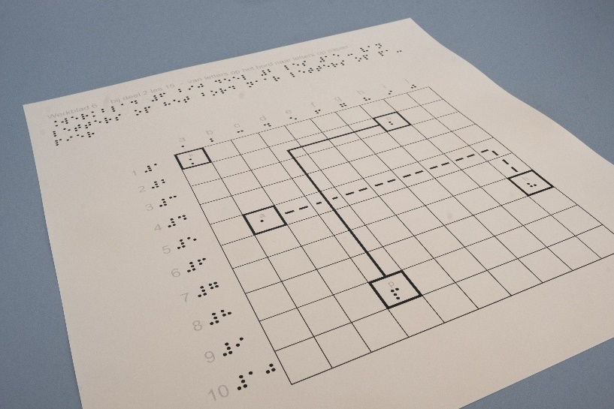
3D to 2D

Slide 6
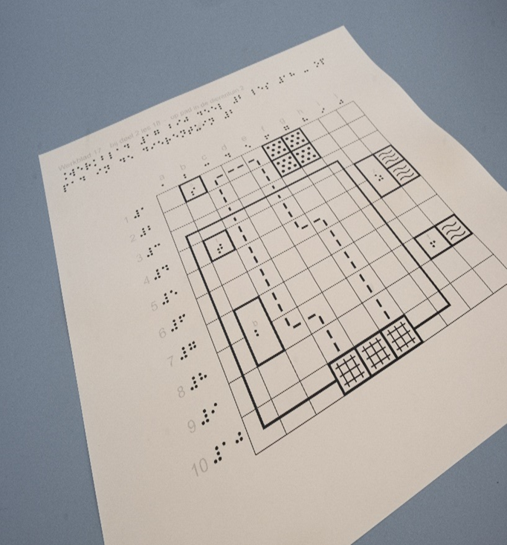
More and more tactile information

Slide 7
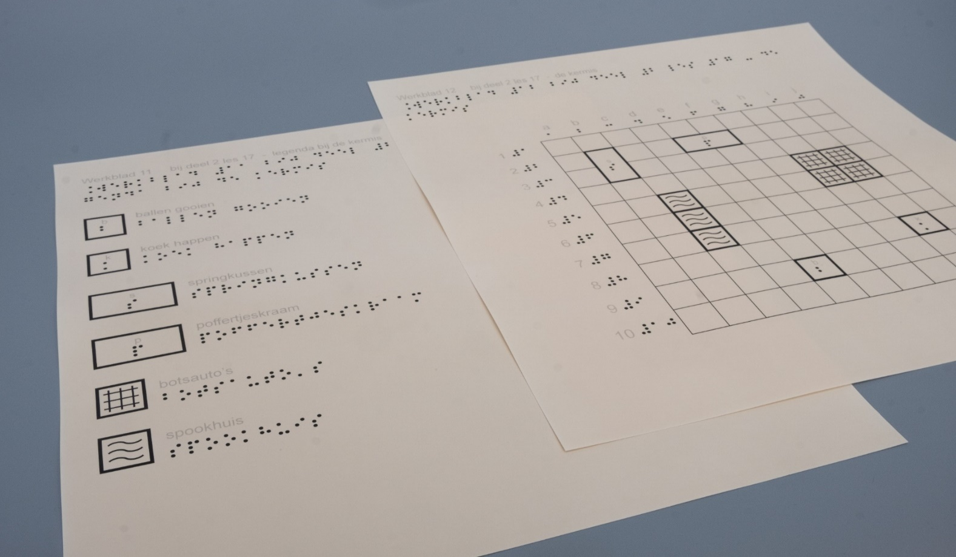
Learning to interpret tactile graphic floorplans with the use of a legend

Slide 8
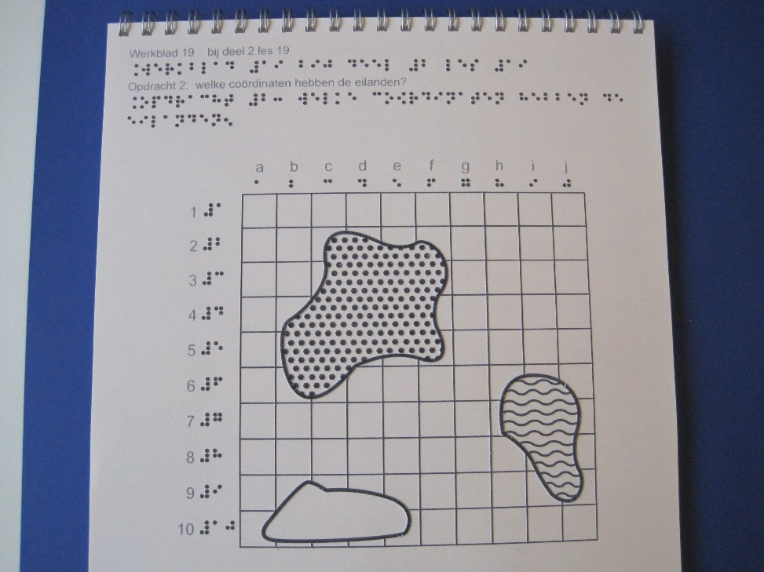
Coordinates
Islands with texture
on the 3D board
And in tactile graphics

Slide 9
Maths: bar charts

Slide 10
Film impressions of lessons

Slide 11
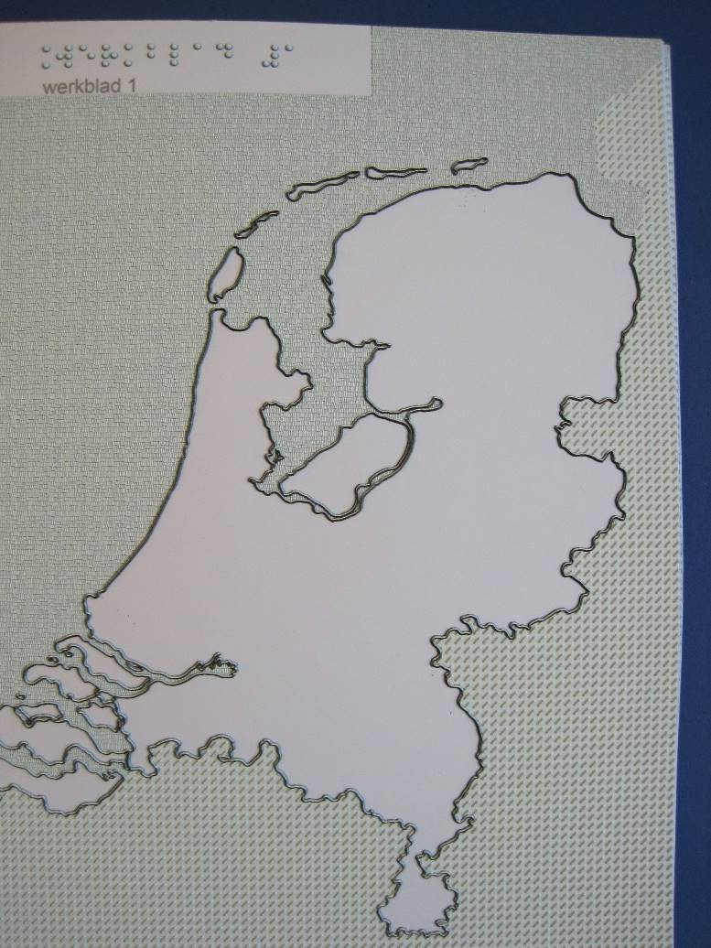
Where am I? Map of The Netherlands

Slide 12
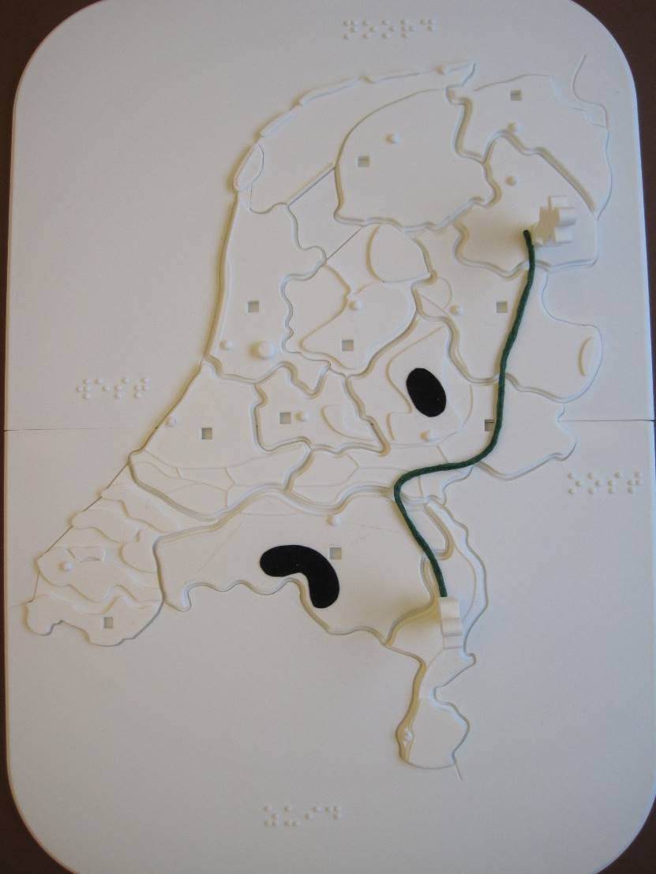
An on her way to Jan

Slide 13
Game to help processing all information
Which province is this?
The teacher gives information like this province is next to the German border.
Also a characteristic feature of the provinces is mentioned
After this the method of Dedicon “By touch---topo The Netherlands” can be used.

Slide 14
Questions?
Send an e-mail to anenjan@visio.org
For more information ​
about this presentation and the presented products visit​​
www.visio.org/tactile-reading-2021​​

