Slide 1
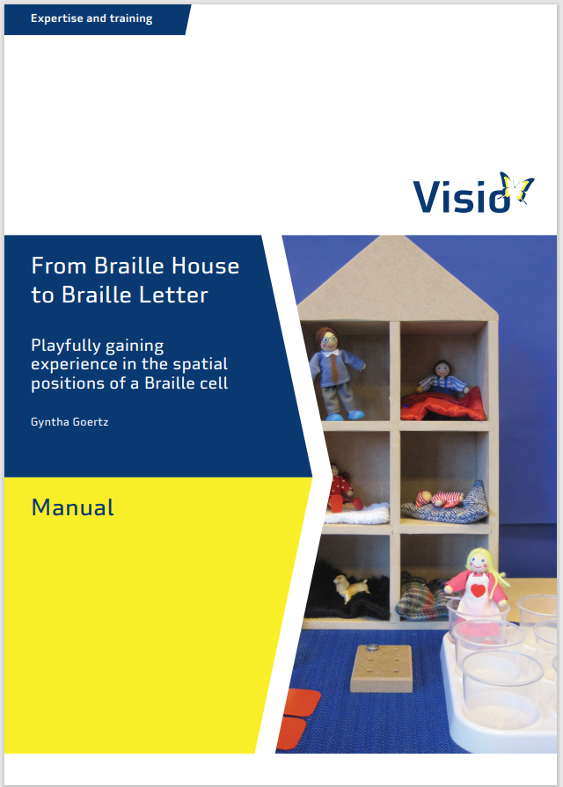
Gyntha Goertz
Linda Verhoef
Reading concepts:
from Braille house
to Braille letter

Slide 2
Specific skills in the preparatory phase of braille
Language and auditory development
(Fine) motor development
Spatial orientation and reading concepts
Tactual development
Meaning and symbol awareness
Sound-sign connection: learning the braille format
Notes:
Braillecurriculum 2.1 p 4

Slide 3
Spatial development
Spatial information is obtained through touch and movement and hearing (smell) and typically depends on the balance of convergent information from all sources.
(Millar, 1994)

Slide 4
Pre reading concepts:
top, bottom, left, right, top left, top right, bottom left, bottom right, middle, above, below, front, back, first, last, second, same, behind, in front, at the site, in the middle, next, centre left, middle right, short, long, up, down, letter, word, line, sentence, sound, page,
reading direction (from left to right)

Slide 5
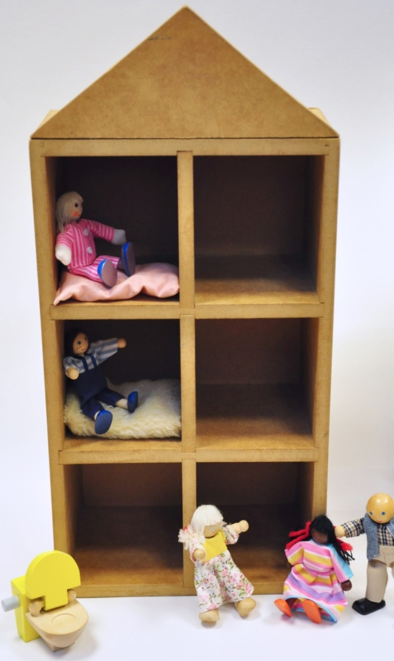
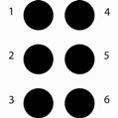
Playfully gaining experience in the spatial positions of a Braille cell
Notes:
Numbering method is an initial aid and tends to drop out later

Slide 6
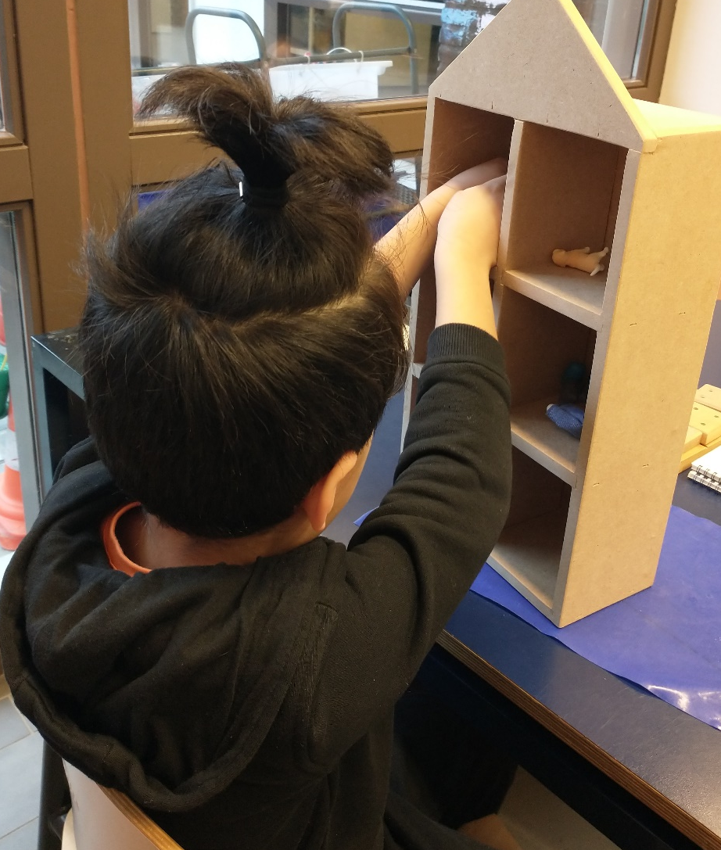
The Braille House with the size of a young child's torso

Slide 7
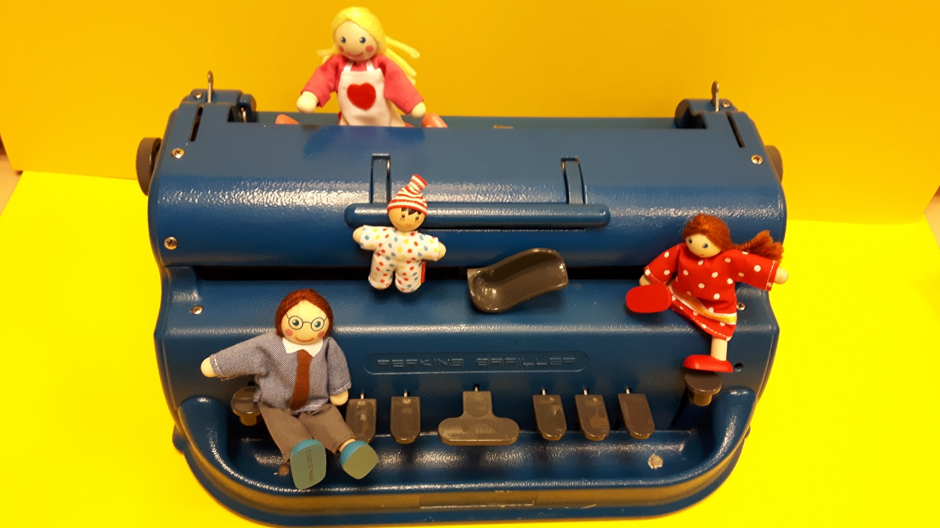
Hockey Cockey song
www.visio.org/tactile-reading-2021

Slide 8
Manual with lesson plans
www.visio.org/tactile-reading-2021
Notes:
In case of reading problems it may be necessary to return to enlarged forms to ensure systematic scanning of a pattern. Mirror image confusions/ Reversals of the pattern left/right and up/down reversals

Slide 9
