Slide 1
Tactile Reading 2021

Slide 2
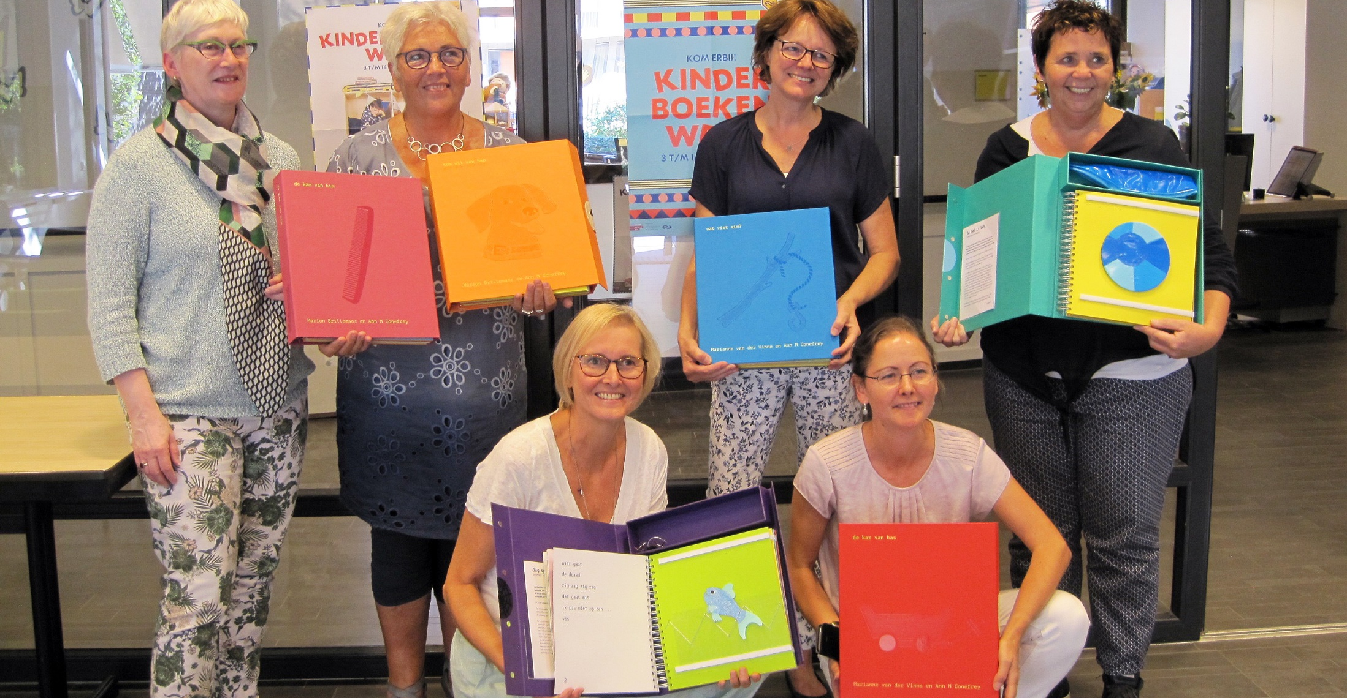
‘Feel Your Reading Book’

Slide 3
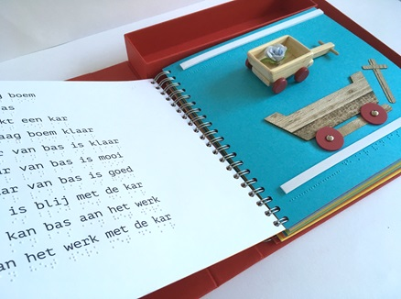
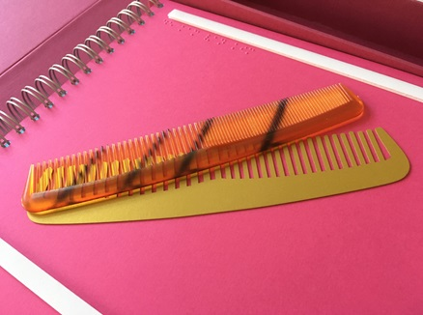
Goals for early braille literacy

Slide 4
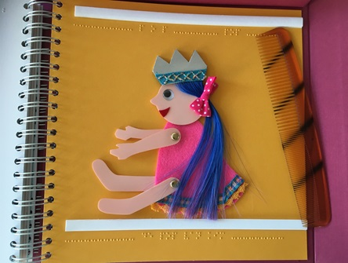
Educational Needs and Requirements
Reading pleasure
Simple stories
Different reading levels
Easy words in braille
Tactile pictures
Tangible object
Reading together

Slide 5
Design Requirements
Real book
Double spreads
Tactile illustrations
Consequent textures
3D object
Attractive

Slide 6
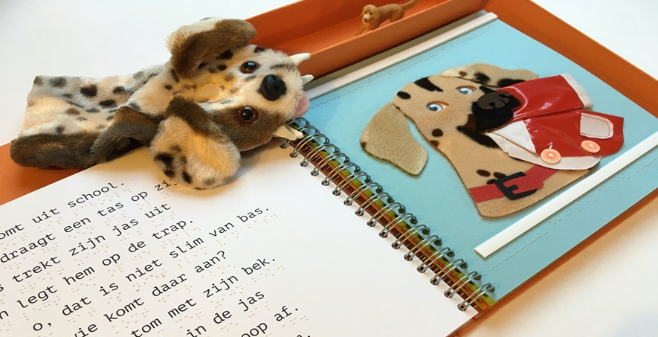
Reading together

Slide 7
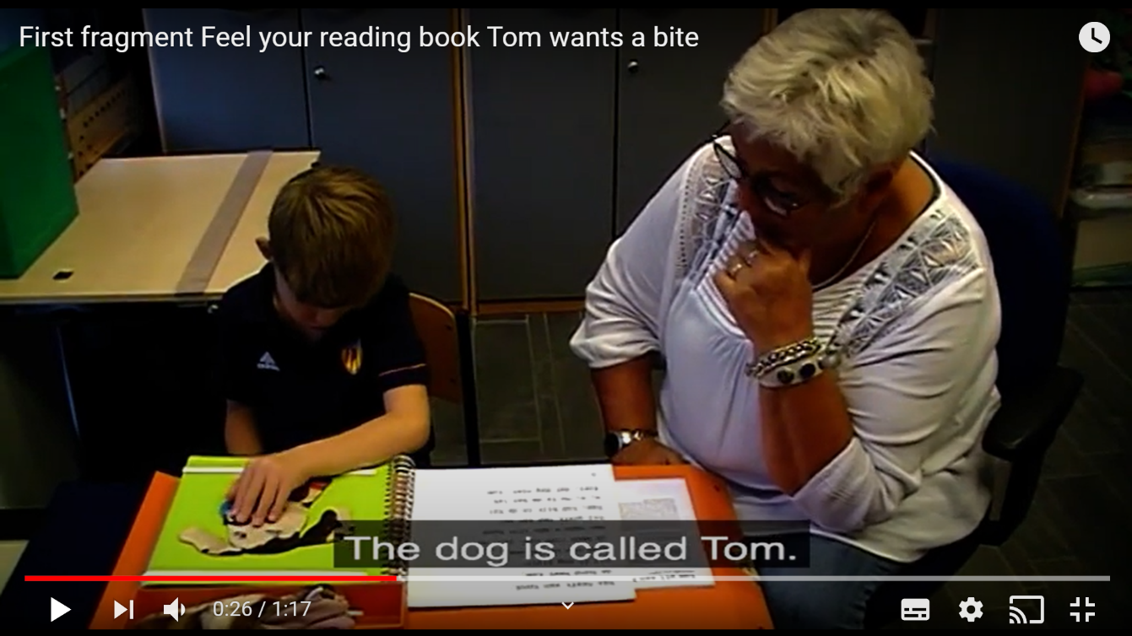
‘Tom wants a bite’
You can watch this video fragment on the Royal Dutch Visio YouTube channel

Slide 8
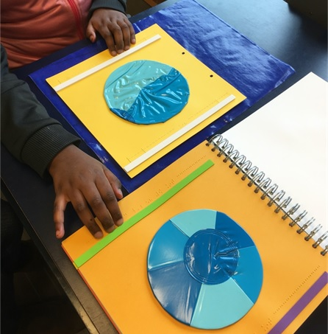
Collaboration
Teachers - designer
Design thinking
Functionality - aesthetics
Investigate solutions
Testing

Slide 9
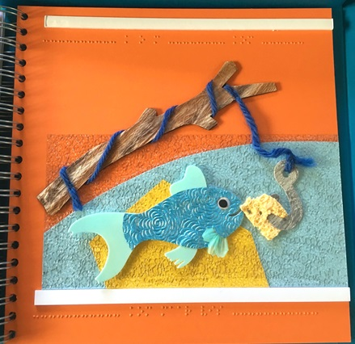
Braille reading technique
Easy word
Word within dotted line
Sentence using the word
Thick strip
Fingers in a row

Slide 10
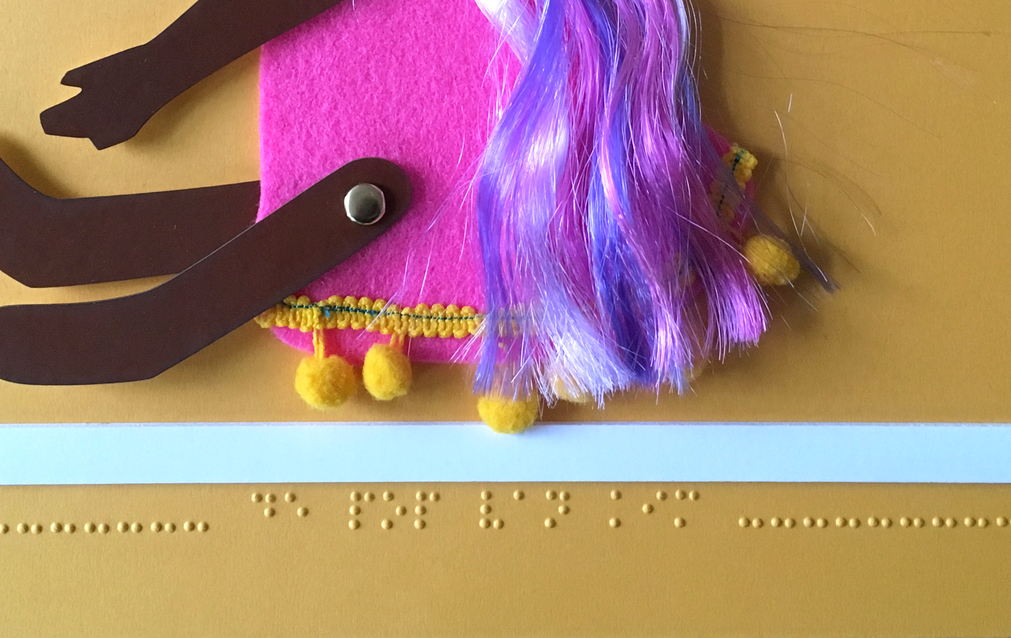
Righthand pages

Slide 11
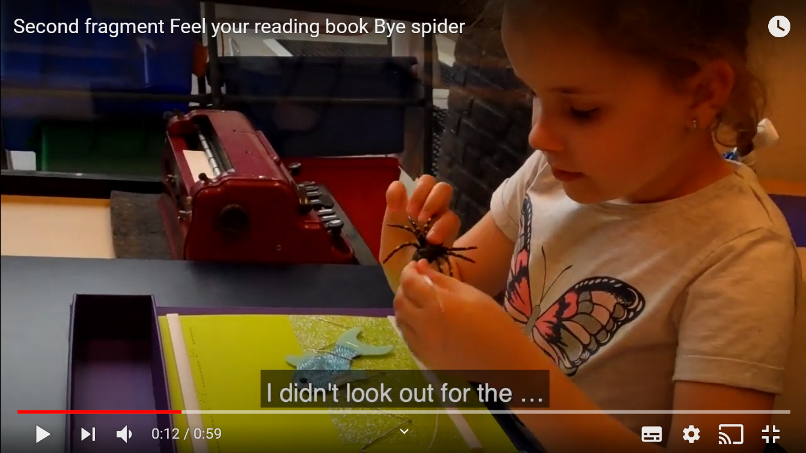
‘Hello spider’
You can watch this video fragment on the
Royal Dutch Visio YouTube channel

Slide 12
Think tactile
Meaningful illustrations
Unique materials
Interaction: story – 3D – 2D
Pretend play
Testing and prototypes

Slide 13
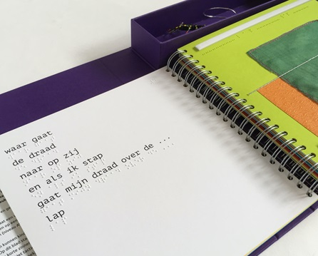
Braille layout
Extra line spacing
Easy words
Sentences on one line
Max. 10 lines per page
Minimize punctuation
Grade 1 braille (no contractions)

Slide 14
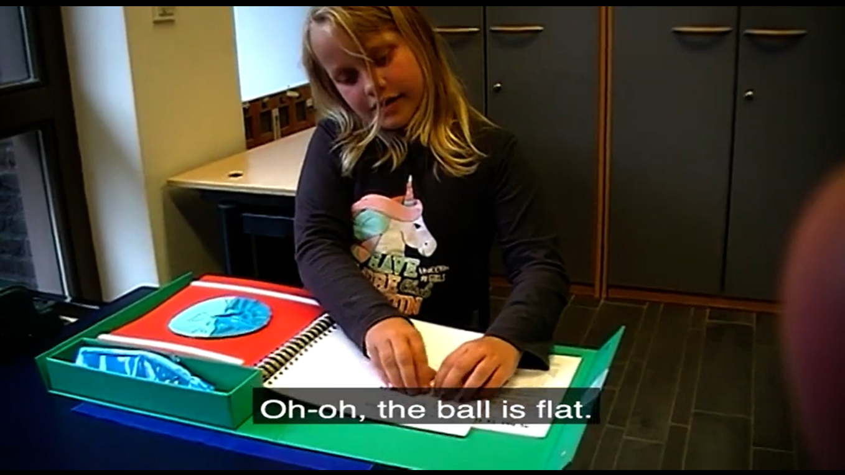
‘The ball is flat’
You can watch this video fragment on the Royal Dutch Visio YouTube channel

Slide 15
Production
No imprint from braille
Cover, binding, pages
Quality materials
Colour contrast
Leaflet for parents: tips, encouragement
Free to borrow

Slide 16
Reading tips for parents

Slide 17
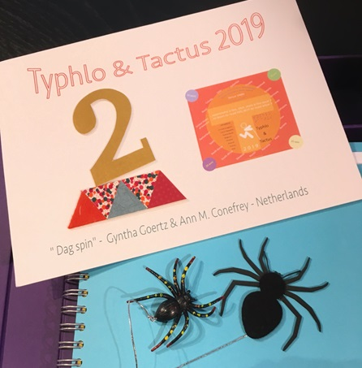
Typhlo & Tactus 2019
International competition for tactile children’s books
2nd prize “dag spin”
(hello spider)

Slide 18
Downloads
Educational criteria: www.visio.org/tactile-reading-2021
Design: www.brailledots.nl

Slide 19
Thank you for your attention!
Gyntha Goertz and Ann Conefrey,
‘Feel Your Reading Book’
Tactile Reading 2021 | Digital Conference
www.visio.org/tactile-reading-2021
www.brailledots.nl

