Slide 1
Assessment of Cerebral Visual Impairment in children with Profound Intellectual and Multiple Disabilities.
Marieke Steendam, occupational therapist
Marjolein Wallroth, child psychologist
Nel Tijmes, ophthalmologist
Visio The Hague/Leiden, Amsterdam

Slide 2
The current situation
Data from just a Formal Visual Assessments (by an orthoptist and/or ophthalmologist) do not provide the full picture of the visual functioning of these children in daily life.
A reliable instrument to assess children with CVI and PIMD has not been developed yet.
The aim of our study is to obtain more insight in the visual functioning of each child which could serve as a basis for intervention.

Slide 3
Two tiered project
Research analysing existing files of children with PIMD
Developing and implementing Visual Assessment Scales as a base for intervention in case of CVI in persons with PIMD

Slide 4
Complexity

Slide 5
The working definition of CVI
1.An eye examination cannot fully explain the child’s use of vision
2.A history or presence of neurological problems, even when the child’s brain imaging studies may appear normal
3.The presence of the behavioral or visual responses of CVI
(Roman-Lantzy e.a.2010)
CVI: a spectrum or umbrella disorder

Slide 6
Sample characteristics (1)
Visual assessments of 73 children with PIMD
3 specialized Daycare Centres
Data from formal Visual Assessment
Medical records about general medical diagnosis, ophthalmology, epilepsy
GMFCS (motor developmental scales)

Slide 7
Sample characteristics (2) N=73
Gender: Male 56,2% Female 43,8%
Age: Between 2.5 and 22.6 (mean 9.3 years)
Epilepsy (N=72 ): 72,2%
Auditory impairment (N=70): 8,6%

Slide 8
Structured observations
Information gathered in observation has been structured into 2 forms:
Characteristics of CVI (derived from literature and CVI-experts)
Levels of Visual Functioning (PIMD)

Slide 9
Characteristics of CVI, mainly signs of impaired visual attention
1. No visual curiosity
2. Looking away when reaching or handling (N=
3. Cursory looks and short visual behaviour
4. Variable visual behaviour
5. Cannot use vision simultaneously to other senses, like hearing or touching
6. Looking is tiring
7. Familiarity gives better visual behaviour and/or recognition
8. Preferes listening above looking
9. Staring into lightsources

Slide 10
Colebrander v.s. this study
Niveau 1 -Totale visuele beperking
Niveau 2- Zeer ernstige visuele beperking
Functioneel blind
Niveau 3 -Ernstige beperking
Passief visueel aandachtsysteem
Niveau 4 - Matige beperking
Basale herkenning
Niveau 5 - Lichte beperking
Duidelijke visuele herkenning
Niveau 6 -Geen beperking
Normaal functioneren
No reaction at all to visual stimuli
Only reaction to visual stimuli in darkened room and/or staring into lightsources
Reaction to strong visual stimuli in normal lighting, no sign of recognition, imaired visual search
Actively searching for visual stimuli, starting to recognise familiar objects or faces,
Is visually alert and improved recognition, visual activities remain short and tiring
Normal visual behaviour and processing
Colebrander, A. (2010). Towards the development of a classification of vision related functioning- a potential framework. Dutton, G.N. & Bax, M (Eds.), Visual impairment in children due to damage to the brain (pp 282-293). Londen, UK, Mac Keith Press

Slide 11
Results

Slide 12
Level of visual acuity, using the WHO norms
Sub normal > 0.3 34.2 %
Moderate VI (>0.1en <0.3) 28.8 %
Severe VI (<0.1 en >0.05) 13.7%
Profound VI (<0.05 en >0.02) 5.5%
No reliable assessment possible 15.1%
Conclusion: 50,7% of the 73 children have measured VI (2,3,4)
15,1% (5) may be assumed to have VI as well.

Slide 13
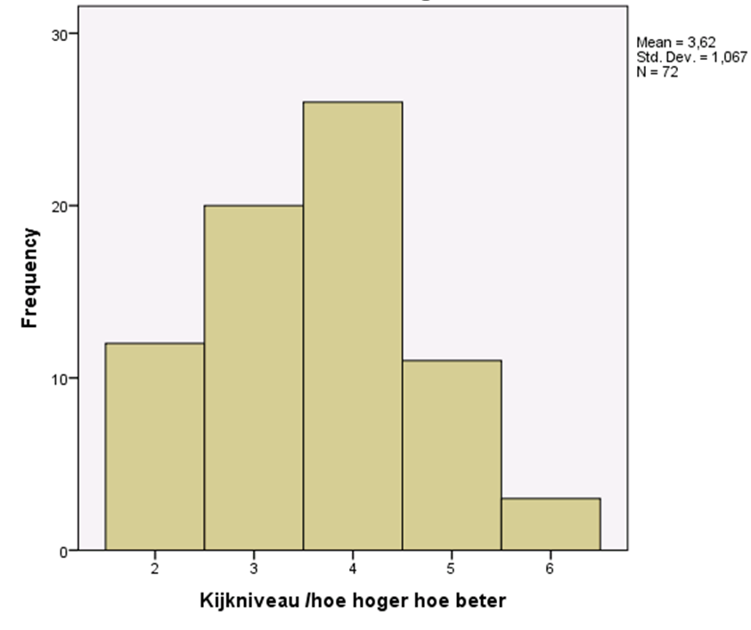
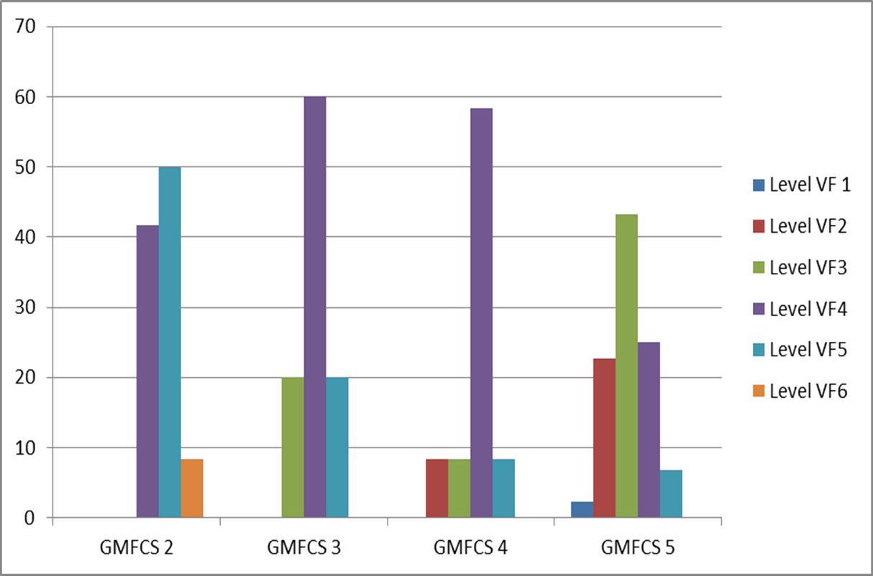
Level of visual functioning

Slide 14
Ophthalmological results

Slide 15
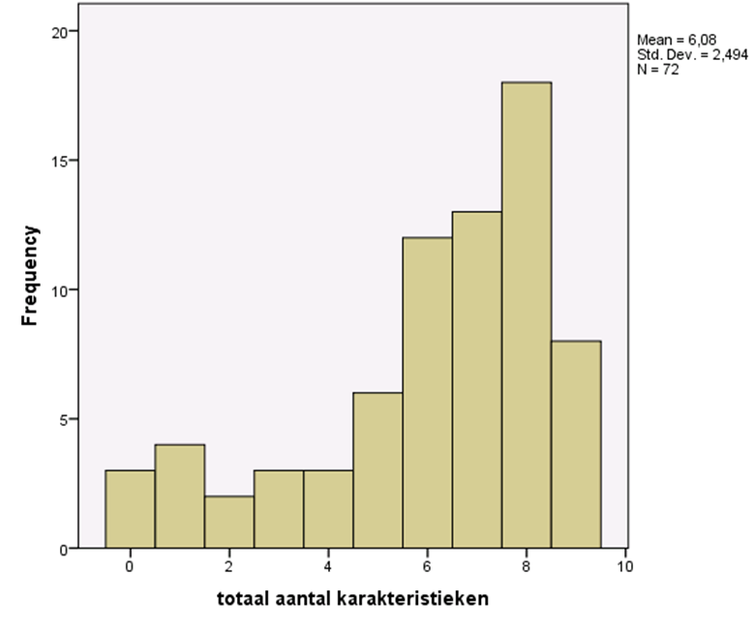
CVI characteristics
Highest prevalence N= 73
Variable Visual Behaviour 95.5 %
Cursory looks 83.5 %
Lowest prevalence N= 73
No visual curiosity 52.1%
Staring into lightsources 54.2%
Total number of CVI Characteristics

Slide 16
Significant correlations
Visual acuity (TAC) and level of visual functioning,
$τ$ = .66, p≤ .001
Visual acuity and total number of characteristics of CVI,
$τ$= .49, p≤ .001
levels of visual functioning and total number of characteristics of CVI
$τ$= -.59 p≤ .001

Slide 17
Future research
The 9 CVI-characteristics in combination with the levels of visual functioning and the formal assessment enhance the insight in the childrens visual functioning
It gives directions for further treatment and advice to parents and carers.
Goal: improve our tools and make them reliable

Slide 18
Take home message

Slide 19
Thank you for your attention
This project is in cooperation with:
University of Groningen, department of Special Needs Education and Youth Care, Annette van der Putten
Radboud University Nijmegen, department of Special Education: Learning and Development, Bert Steenbergen
Bartimeus, specialist centre for blind and visually impaired people in the Netherlands, Mies van Genderen
For contact:
marjoleinwallroth@visio.org
mariekesteendam@visio.org

Slide 20
Colebrander, A. (2010). Towards the development of a classification of vision related functioning- a potential framework. Dutton, G.N. & Bax, M (Eds.), Visual impairment in children due to damage to the brain (pp 282-293). Londen, UK, Mac Keith Press

